Slide 1
SPACE VECTOR PWM (SVPWM)
References
Power Electronics by B K Bose
Power Electronics by Rashid 3rd Edition
High Power Converters and AC Drives by Bin Wu
“SPACE VECTOR MODULATION – An Introduction”, IECON 01 The 27th Annual Conference of the IEEE Industrial Electronics Society.

Slide 2
The main aim of any modulation technique is to obtain variable output having a maximum fundamental component with minimum harmonics.
This objective can be achieved to a large extent by SVPWM method
It is the best technique for variable frequency drive (VFD) applications.
SVM is based on rotating phasor theory.

Slide 3
Basics of rotating phasor theory.
Three phase balanced load voltage system.
This can be represented by a space vector of magnitude V_{m} rotating with an angular velocity of ω .

Slide 4
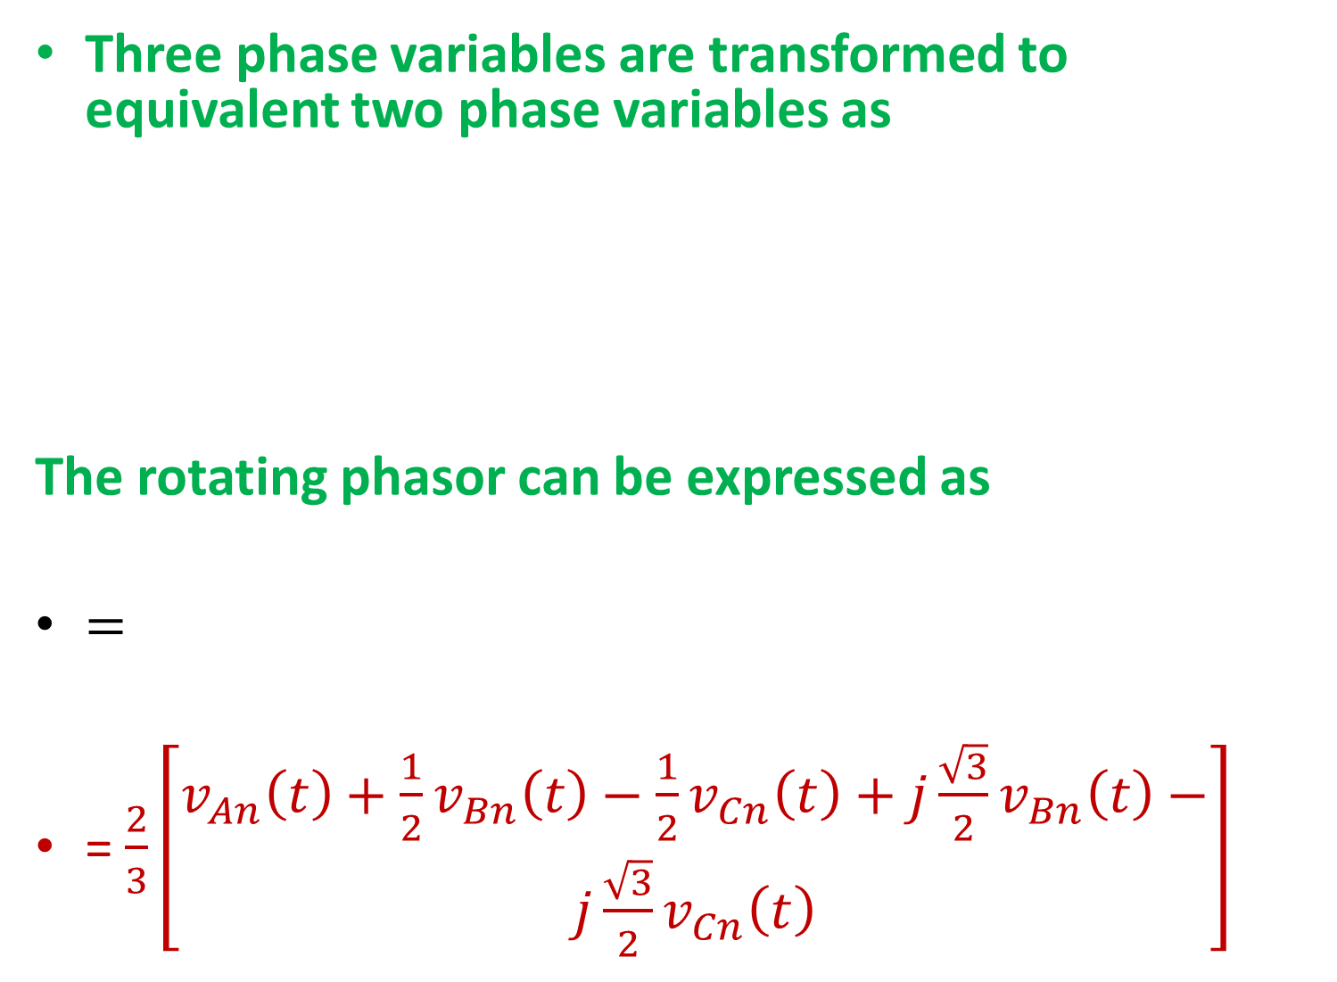
Three phase variables are transformed to equivalent two phase variables as
The rotating phasor can be expressed as
$=$
= $\frac{2}{3}\left[\begin{aligned}v_{An}\left(t\right)+\frac{1}{2}v_{Bn}\left(t\right)−\frac{1}{2}v_{Cn}\left(t\right)+j\frac{\sqrt{3}}{2}v_{Bn}\left(t\right)− \\ j\frac{\sqrt{3}}{2}v_{Cn}\left(t\right)\end{aligned}\right]$

Slide 5
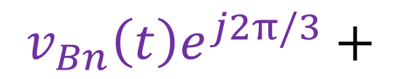

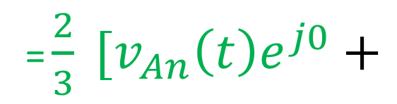
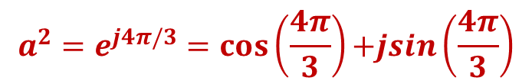
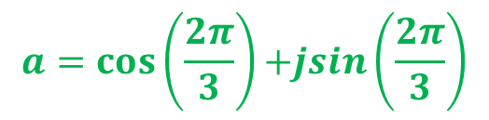
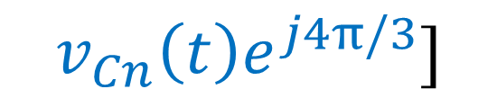
$=\frac{2}{3}\left[\begin{aligned}v_{An}\left(t\right)+\frac{1}{2}v_{Bn}\left(t\right)−\frac{1}{2}v_{Cn}\left(t\right)+j\frac{\sqrt{3}}{2}v_{Bn}\left(t\right)− \\ j\frac{\sqrt{3}}{2}v_{Cn}\left(t\right)\end{aligned}\right]$
= $\frac{2}{3} [v_{An}\left(t\right)e^{j0}+$
$$v_{Bn}\left(t\right)e^{j2π/3}+$$
$$v_{Cn}\left(t\right)e^{j4π/3}]$$
$$a=cos\left(\frac{2π}{3}\right){+jsin\left(\frac{2π}{3}\right)}$$
$$a^{2}=e^{j4π/3}=cos\left(\frac{4π}{3}\right){+jsin\left(\frac{4π}{3}\right)}$$

Slide 6



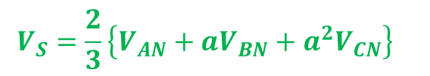


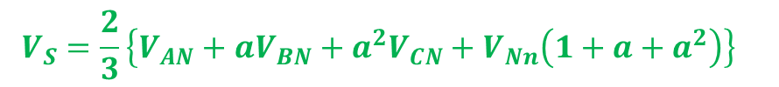
$$V_{S}$$
$$V_{An}=V_{AN}+V_{Nn}$$
$$V_{Bn}=V_{BN}+V_{Nn}$$
$$V_{Cn}=V_{CN}+V_{Nn}$$
$$V_{S}=\frac{2}{3}{\left\{V_{AN}+aV_{BN}+a^{2}V_{CN}+V_{Nn}\left(1+a+a^{2}\right)\right\}}_{}$$
$${\left\{\left(1+a+a^{2}\right)\right\}=0}_{}$$
$$V_{S}=\frac{2}{3}{\left\{V_{AN}+aV_{BN}+a^{2}V_{CN}\right\}}_{}$$

Slide 7
$$V_{S}$$

Slide 8
Switching States of Three Phase Two Level Inverter
Devices | State | Equivalent Circuit | V_{An} | V_{Bn} | V_{Cn} | Space Vector
T₆ T₁ T₂ | 1
a²
T₁ T₂T₃ | 2
a

Slide 9
T₂ T₃T₄ | 3
T₃ T₄T₅ | 4
T₄ T₅T₆ | 5

Slide 10
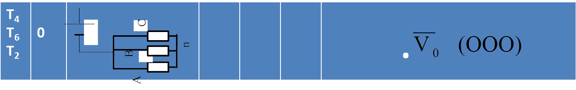
T₁ T₆T₅ | 6
T₁ T₃T₅ | 7 |  |  |  |  | .
Vectors V₁, V₂, V₃, V₄, V₅, V₆ are called active vectors
Vectors V₀ and V₇ are called zero vectors

Slide 12
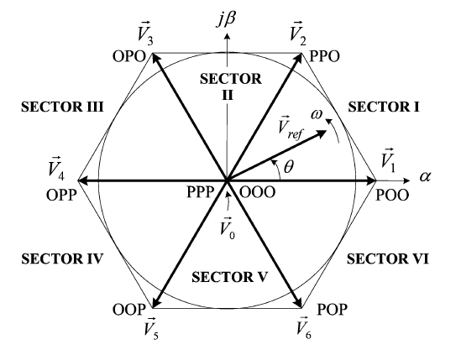
The active vectors are π/3 angle apart with magnitude 2V_{d}/3 and tip of the vectors occupy the corners of a regular hexagon.
Zero vectors and are at the origin.

Slide 13
Active and zero vectors do not move in space and they are referred to stationary vectors.
For three phase square wave operation of the inverter, the vector sequence is , , , , ,
Each vector represent the inverter for an angle of π/3 or a period of T/6 and there are no zero vectors.
V_{An}
V₁(POO)
V₂(PPO)
V₃(OPO)
V₄(OPP)
V₅(OOP)
V₆(POP)
V₁(POO)

Slide 14
Space Vector PWM
desired output voltage of the three phase inverter
Desired peak magnitude of output is V_{m}*
desired output frequency is ω*.
This three phase reference voltage results in a reference space vector of magnitude V_{m}* and rotates with an angular velocity of ω*.
Inverter switches are controlled such that its output voltage phasor follows closely

Slide 15
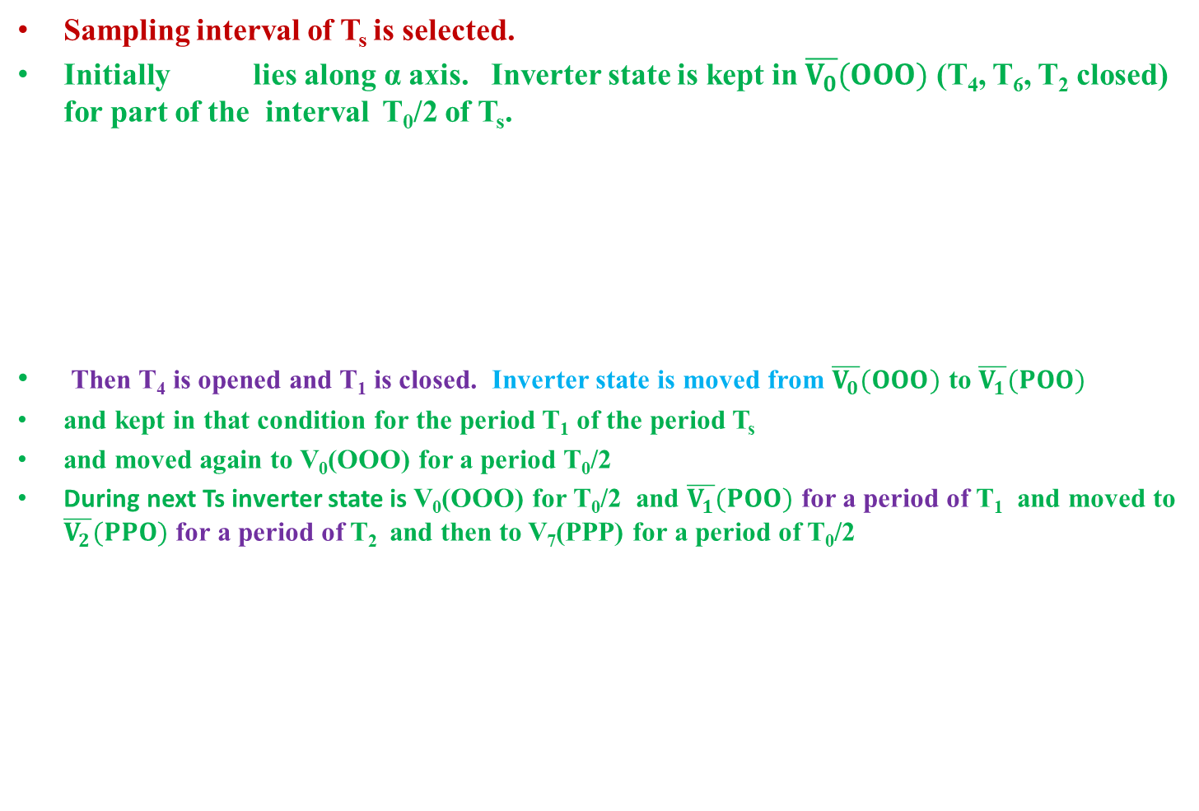
Sampling interval of T_{s} is selected.
Initially lies along α axis. Inverter state is kept in $\overline{V_{0}}(OOO)$ (T₄, T₆, T₂ closed) for part of the interval T₀/2 of T_{s}.
Then T₄ is opened and T₁ is closed. Inverter state is moved from $\overline{V_{0}}(OOO)$ to $\overline{V_{1}}(POO)$
and kept in that condition for the period T₁ of the period T_{s}
and moved again to V₀(OOO) for a period T₀/2
During next Ts inverter state is V₀(OOO) for T₀/2 and $\overline{V_{1}}(POO)$ for a period of T₁ and moved to $\overline{V_{2}}(PPO)$ for a period of T₂ and then to V₇(PPP) for a period of T₀/2
V_{AN}
T_{s}
2T_{s}
3T_{s}
V_{BN}
V_{CN}
N

Slide 16
Consider that at an instant lies in Sector I.
and are closer to .
Inverter switches are controlled such that its state is along
(POO) for a period of T₁ ( on devices T6 T1 T2)
(PPO) for a period of T₂ (on devices T1 T2 T3)
(OOO) (T6 T4 T2) or (PPP) (T1 T5 T3) for a period of T₀
V_{d}
N

Slide 17
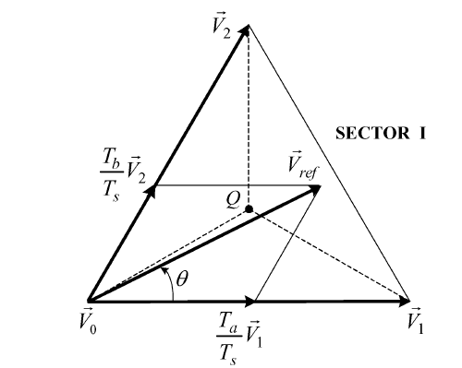
Calculation of Dwell period for each state
is resolved into two components
v_{a} along
and v_{b} along
Dwell periods T_{1 ,} T₂ and T₀ are decided by the position θ
By volt –second balance equation,
v_{b}
v_{a}

Slide 18
Splitting into real and imaginary components along real and imaginary axes,
v_{b}
v_{a}
(1)
(2)
(1)
(-)
(2)

Slide 19
If θ = π/6 , T₁ = T₂
When θ increases or when is closer to V₂ , T₂ › T₁
When is coincident with V₂ , T₁ = 0
When tip of is coincident with Q, T₁ = T₂ = T₀
v_{b}
v_{a}

Slide 20
Switching Sequence
Switching sequence is designed such that switching
frequency is minimum so as to have minimum loss.
To achieve this, two conditions
are to be satisfied.
1. For the transition from
one switching state to the next
involves turn on and turn off
a switch in the same leg.
2. Transition of from one sector to the next involves no or minimum number of switching.

Slide 21
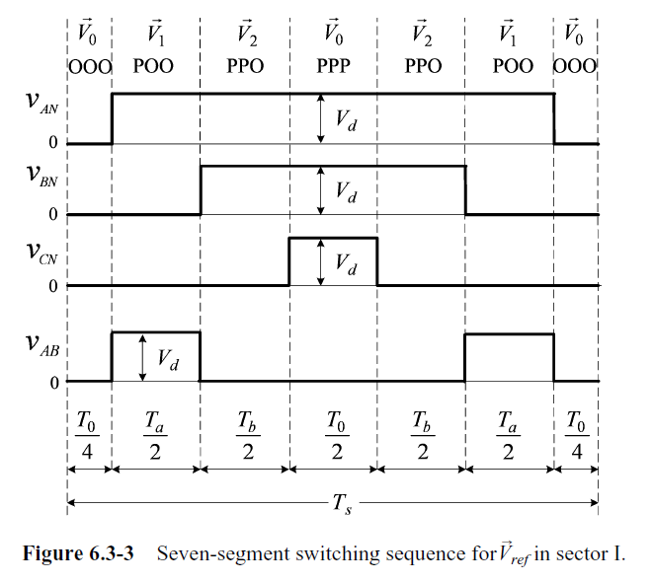
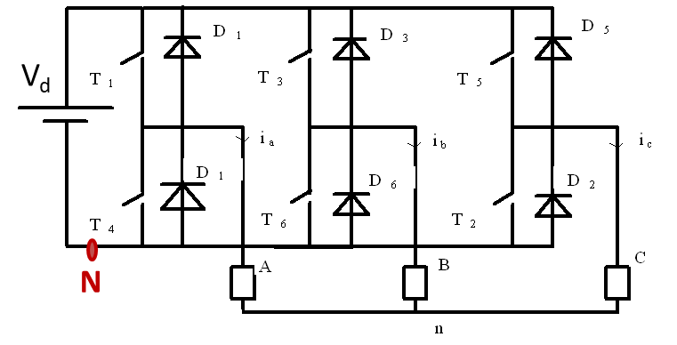
Sampling period T_{s} is divided into seven segments for the adjacent vectors.
For Sector I
OOO
POO
PPO
PPP
PPO
POO
OOO
T₄T₆ T₂
T₁T₆ T₂
T₁T₃ T₂
T₁T₃ T₅
T₁T₃ T₂
T₁T₆ T₂
T₄T₆ T₂
T₀/4
T₁/2
T₂/2
T₀/2
T₂/2
T₁/2
T₀/4
A
B
C
T₁/2
T₂/2
T₁/2
T₂/2

Slide 22
For Sector I
T₂T₄ T₆
T₁T₆ T₂
T₁T₃ T₂
T₁T₃ T₅
T₁T₃ T₂
T₁T₆ T₂
T₂T₄ T₆
OOO
PPO
OOO
POO
PPP
PPO
POO
V_{AN}
T_{S}
V_{BN}
V_{CN}
V_{AB}
T₀/4
T₁/2
T₂/2
T₂/2
T₁/2
T₀/4
T₀/2
A
B
C

Slide 23
For Sector I
T₂T₄ T₆
T₁T₃ T₂
T₁T₃ T₅
T₁T₃ T₂
T₂T₄ T₆
T₂T₄ T₆
T₁T₃ T₂
T₁T₃ T₅
T₁T₃ T₂
T₁T₆ T₂
T₂T₄ T₆
T₁T₆ T₂
T₁T₆ T₂
T₁T₆ T₂
OOO
PPO
OOO
OOO
PPO
OOO
POO
PPP
PPO
POO
POO
PPP
PPO
POO
V_{AN}
V_{AN}
T_{S}
T_{S}
V_{BN}
V_{BN}
V_{CN}
V_{CN}
V_{AB}
V_{AB}
T₀/4
T₁/2
T₂/2
T₂/2
T₁/2
T₀//4
T₁//2
T₂//2
T₂//2
T₁//2
T₀//4
T₀/2
T₀/4
T₀//2

Slide 24
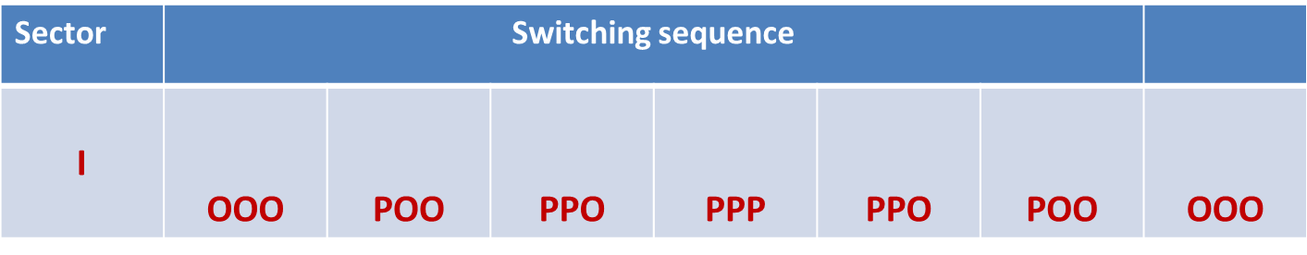
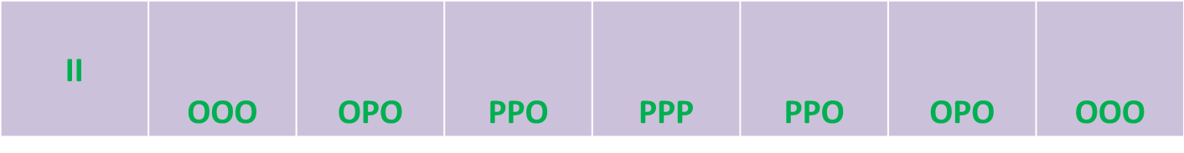
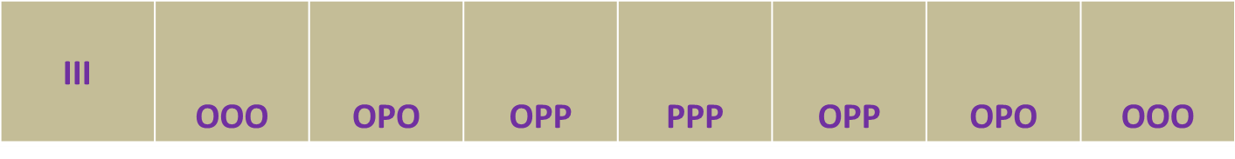

Slide 25
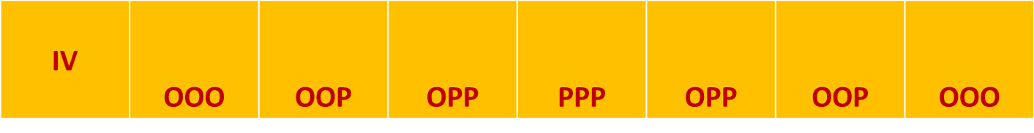
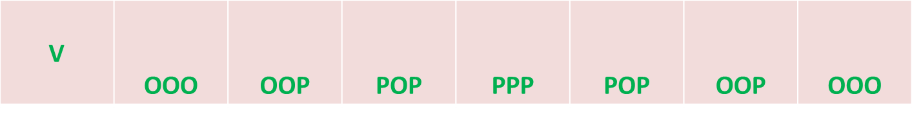
IV
V
VI | OOO | POO | POP | PPP | POP | POO | OOO
VI

Slide 26
II
III
IV
V
VI | OOO | POO | POP | PPP | POP | POO | OOO
VI

Slide 27
Zero state PPP is used at middle and zero state OOO is used at the beginning and end to minimise switching.
Each switch is turned on and off once in one T_{s}.
Number of switching in one second = 1/ T_{s}
Switching frequency of each device = 1/T_{s}
= sampling frequency
Sector I
OOO
PPO
OOO
POO
PPP
PPO
POO
V_{AN}
T_{S}
T₂T₄ T₆
T₁T₆ T₂
T₁T₃ T₂
T₁T₃ T₅
T₁T₃ T₂
T₁T₆ T₂
T₂T₄ T₆
V_{BN}
V_{CN}
V_{AB}
T₀/4
T₁/2
T₂/2
T₂/2
T₁/2
T₀/4
T₀/2

Slide 28
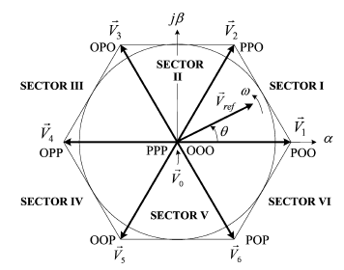
Modulation Index
Maximum possible value of reference phasor is
Maximum possible value of modulation index is

Slide 29
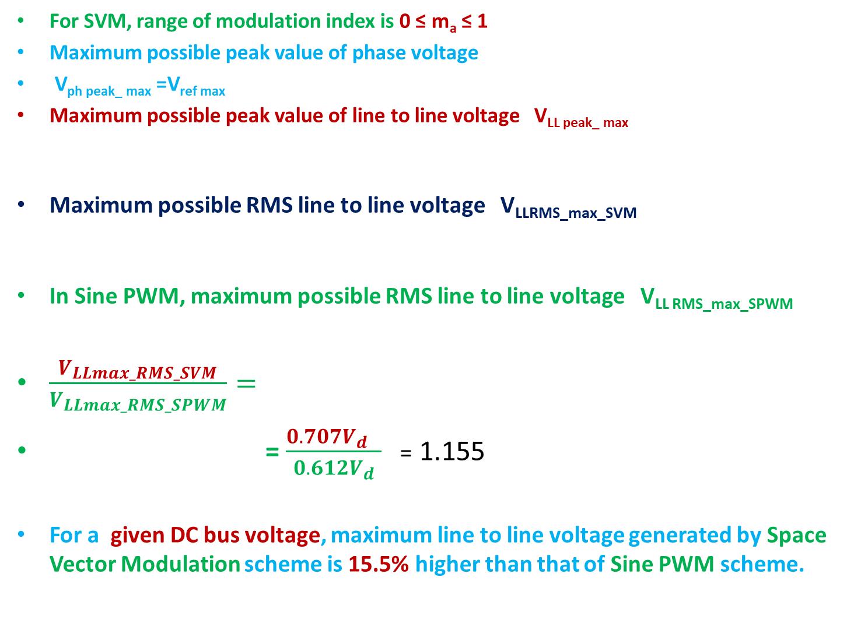
For SVM, range of modulation index is 0 ≤ m_{a} ≤ 1
Maximum possible peak value of phase voltage
V_{ph peak_ max} =V_{ref max}
Maximum possible peak value of line to line voltage V_{LL peak_ max}
Maximum possible RMS line to line voltage V_{LLRMS_max_SVM}
In Sine PWM, maximum possible RMS line to line voltage V_{LL RMS_max_SPWM}
$\frac{V_{LLmax_RMS_SVM}}{V_{LLmax_RMS_SPWM}}=$
= $\frac{{0.707V}_{d} }{{0.612V}_{d}}$ = 1.155
For a given DC bus voltage, maximum line to line voltage generated by Space Vector Modulation scheme is 15.5% higher than that of Sine PWM scheme.

Slide 30
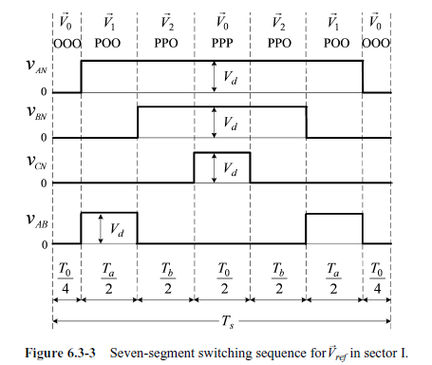
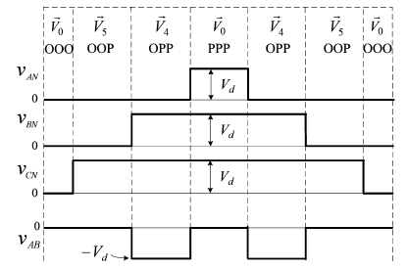
V_{AB} in Sector I
V_{AB} in Sector IV
V_{AB} is not half wave symmetrical.
V_{AB} (ωt) ≠ - V_{AB} (ωt+π)
Even harmonics are present.
Type A starts and ends with [000]
Type B starts and ends with [PPP]

Slide 31
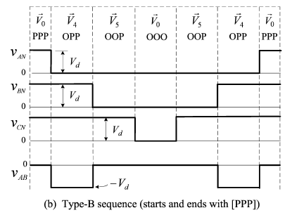
Even order harmonic elimination
Type A switching sequence in Sector I
Type B switching sequence in Sector IV
c

Slide 32
Type A starts and ends with [000]
V_{AB} (ωt) = -V_{AB} (ωt+π)
To make line to line voltage symmetrical, each sector is divided into two regions.
TypeA and TypeB switching sequences can be alternately used in each regions.
Even order harmonic elimination is achieved at the expense of an increased switching frequency
Type B starts and ends with [PPP]
OPO
PPO
a
b
OPP
POO
b
a
Increase in switching frequency is
a
b
6f₁
POP
OOP

Slide 33
Switching sequence design is not unique for a given set of stationary vectors and dwell times.
Five segment scheme for TypeA switching
Sector 1
T₂T₄ T₆
T₁T₆ T₂
T₁T₆ T₂
T₂T₄ T₆
OOO
T₁T₃ T₂
POO
PPO
POO
OOO
V_{AN}
T_{S}
V_{BN}
V_{CN}
V_{AB}
T₀/2
T₁/2
T₂
T₁/2
T₀/2

Slide 34
Five segment scheme for TypeB switching
Sector 1
T₁T₃ T₅
T₁T₃ T₂
T₁T₆ T₂
T₁T₃ T₅
T₁T₃ T₂
PPP
PPO
POO
PPO
PPP
V_{AN}
T_{S}
V_{BN}
V_{CN}
V_{AB}
T₀/2
T₂/2
T₁
T₂/2
T₀/2

Slide 35
In five segment scheme, any one of the three inverter output terminals is clamped to either the positive or negative of dc bus without any switching during one T_{s}

Slide 36
Sector
Switching sequence
I | OOO | POO | PPO | POO | OOO | V_{CN} = 0
II | OOO | OPO | PPO | OPO | OOO | V_{CN} = 0
III | OOO | OPO | OPP | OPO | OOO | V_{AN} = 0
IV | OOO | OOP | OPP | OOP | OOO | V_{AN} = 0
V | OOO | OOP | POP | OOP | OOO | V_{BN} = 0
VI | OOO | POO | POP | POO | OOO | V_{BN} = 0

Slide 37
The switching sequence can be arranged such that the switching in an inverter leg can be continuously suppressed for two sectors or for a period of 2π/3 per cycle.
Due to switching discontinuity, five segment scheme is called discontinuous SVM.

Slide 38
In Type A switching scheme, Conduction angles of lower switches are more than those of upper switches.
This causes unequal power and thermal distribution.
Switching is reduced. Line to line voltages are not half wave symmetrical.
Contains even order harmonics.

